Slide 1

Impact of Healthcare-associated Acquisition on Community-onset Gram-negative Bloodstream Infection
Group 20
Wang Tianqi
Cao Shuwei

Slide 2
AGENDA
Introduction
Objectives
Data Collection
Statistical Analysis
Results
Findings
Strengths & Limitations
Conclusions
Q&A

Slide 3
COMMUNITY-ONSET INFECTION:
INTRODUCTION
Defined as an infection diagnosed within the first 48 hours of hospitalization

Slide 4
INTRODUCTION
COMMUNITY-ONSET
HEALTHCARE-ASSOCIATED
history of a >48-h hospital admission in the previous 90 days,
hemodialysis, intravenous medication, home wound care in the previous 30 days,
or residence in a nursing home or long-term care facility
COMMUNITY-ACQUIRED
Cases that did not meet those criteria

Slide 5
1.7 million
98,987 Deaths
30,665 Bloodstream Infections
Estimated healthcare-associated infections
in 2002 across U.S. hospitals
31%
Klevens, R Monina et al. "Estimating Health Care-associated Infections and Deaths in U.S. Hospitals, 2002." Public Health Reports 122.2 (2007): 160–166.

Slide 6
INTRODUCTION
GRAM-NEGATIVE
BLOODSTREAM INFECTION (BSI):
Caused by Gram-negative bacteria, which is resistant to multiple drugs and are increasingly resistant to most available antibiotics.

Slide 7
“The prevention of healthcare-associated infections is a top priority”
- U.S. Department of Health and Human Services (HHS)
“We keep monitoring gram-negative healthcare-associated infections and capture information on antibiotic resistance patterns”
- U.S. Centers for Disease Control and Prevention (CDC)

Slide 8
OBJECTIVES
For healthcare-associated (HCA) and community-acquired (CA) Gram-negative BSI:
Determine incidence rates by age, gender, and year
Compare causative pathogens and antimicrobial resistance
Compare short/long-term mortality rates and associated risk factors
Optimize empiric antimicrobial
therapy

Slide 9
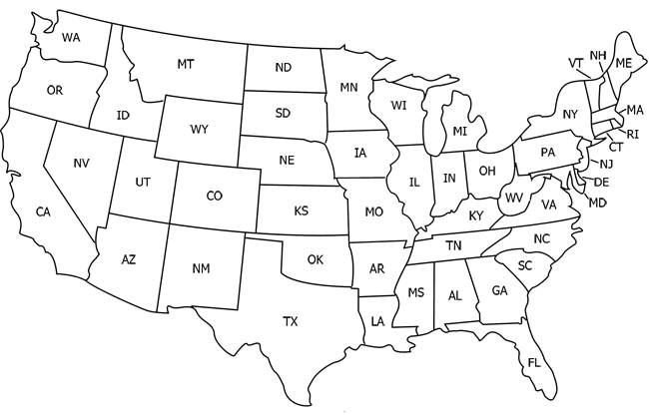
DATA COLLECTION
Olmsted County
Olmsted County, Minnesota, the U.S.
733 patients with community-onset Gram-negative BSI
1 Jan 1998 – 31 Dec 2007

Slide 10
DATA COLLECTION
Olmsted County
Excluded residents lived outside the county, and patients with recurrent episodes of BSI
Laboratory Databases from the only 2 Medical Centers
The Rochster Epidemiology Project (REP) medical records-linkage system
Notes:
udy, we used the microbiologylaboratory databases at both institutions to identify all patientswith Gram-negative BSI during the study period. Using theREP tools, we identified residents of Olmsted County,Minnesota, for inclusion in the study and excluded thosewho lived outside Olmsted County at the tim

Slide 11
STATISTICAL ANALYSIS
1st Objective –
Incidence rates by age, gender and year
2nd Objective –
Causative pathogens and antimicrobial resistance
3rd Objective –
Mortality rates and risk factors
Descriptive statistics: medians, interquartile range (IQR), etc.
Chi-squared test: categorical variables
Wilcoxon rank-sum test: continuous variables
Define variables: age, gender, year, source of infection, site of acquisition
Univariate model: if p value <=0.10
Multivariate logistic regression: variable included
Odds ratios (OR) with 95% CI: strength of association
The Kaplan–Meier method: Patients were followed from the date of Gram-negative BSI until death
Cox proportional hazard regression
Hazard ratios (HR) with 95% CI

Slide 12
Results
Let’s start with the statistics and graphs

Slide 13
RESULTS
Demographic and clinical features
Epidemiology
Microbiology
Antimicrobial resistance
Mortality
Notes:
Demographic and clinical features
In community onset BSI, 41.7% was healthcare-associated and 58.3% was community-acquired.
Healthcare-associated: median age was 73 and 54.9% were female.
Community-acquired: median age was 66 and 59.3% were female.
Primary source of infection: both were the urinary tract.

Slide 14
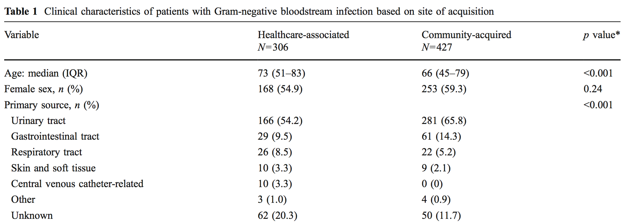
RESULTS Demographic and clinical features
Notes:
Demographic and clinical features
In community onset BSI, 41.7% was healthcare-associated and 58.3% was community-acquired.
Healthcare-associated: median age was 73 and 54.9% were female.
Community-acquired: median age was 66 and 59.3% were female.
Primary source of infection: both were the urinary tract.

Slide 15
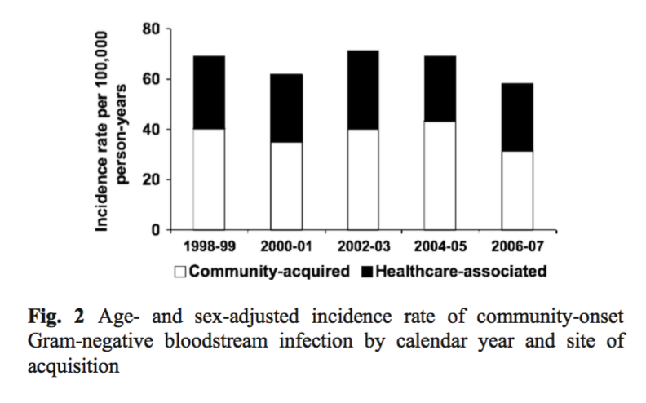
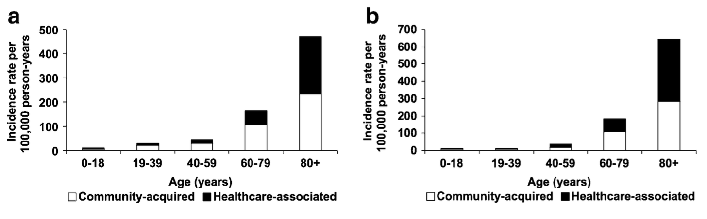
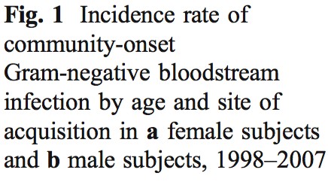
RESULTS Epidemiology
Notes:
Epidemiology
The incidence rates of healthcare-associated and community- acquired Gram-negative BSI increased with age in both female and male subjects.

Slide 16
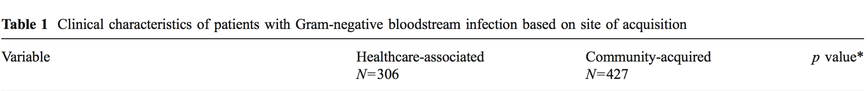
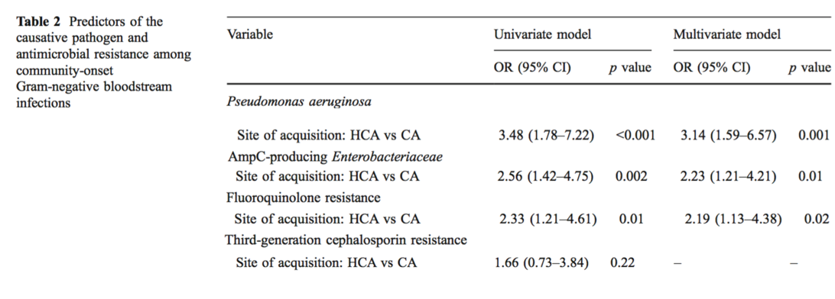
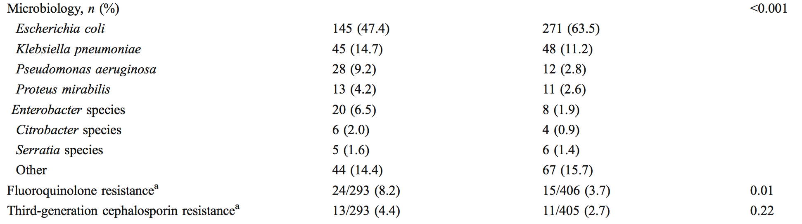
RESULTS Microbiology
Notes:
Microbiology
Escherichia coli was the predominant cause of both situations
Compared two types of BSI, P. aeruginosa was a more common cause of healthcare-associated BSI than those with community-acquired BSI (9.2% vs 2.8%).

Slide 17
RESULTS Antimicrobial Resistance
Notes:
Among two types of BSI, 8.2% and 3.7% respectively were resistant to fluoroquinolones ; 4.4% and 2.7% respectively were resistant to third-generation cephalosporins
There was a linear increase in fluoroquinolone resistance among healthcare-associated Gram-negative bloodstream isolates between 1998 and 2007

Slide 18
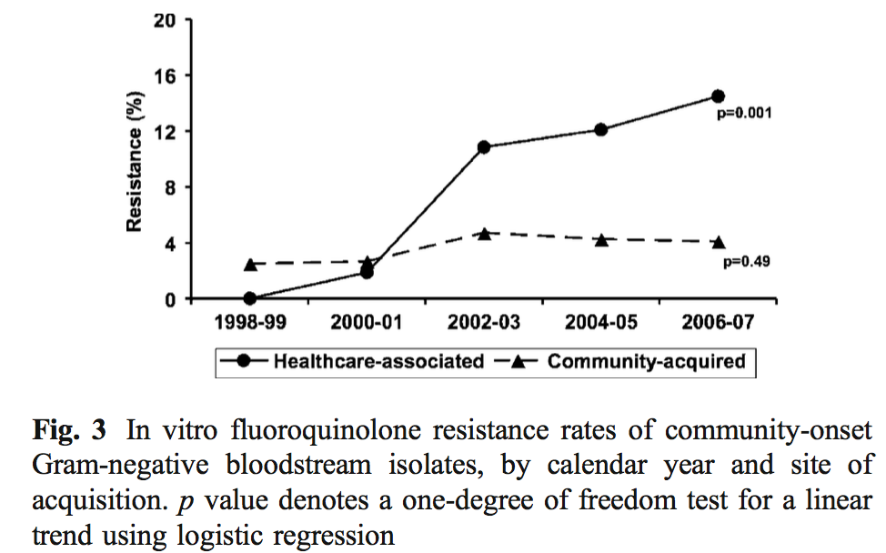
RESULTS Antimicrobial Resistance
Notes:
Among two types of BSI, 8.2% and 3.7% respectively were resistant to fluoroquinolones ; 4.4% and 2.7% respectively were resistant to third-generation cephalosporins
There was a linear increase in fluoroquinolone resistance among healthcare-associated Gram-negative bloodstream isolates between 1998 and 2007

Slide 19
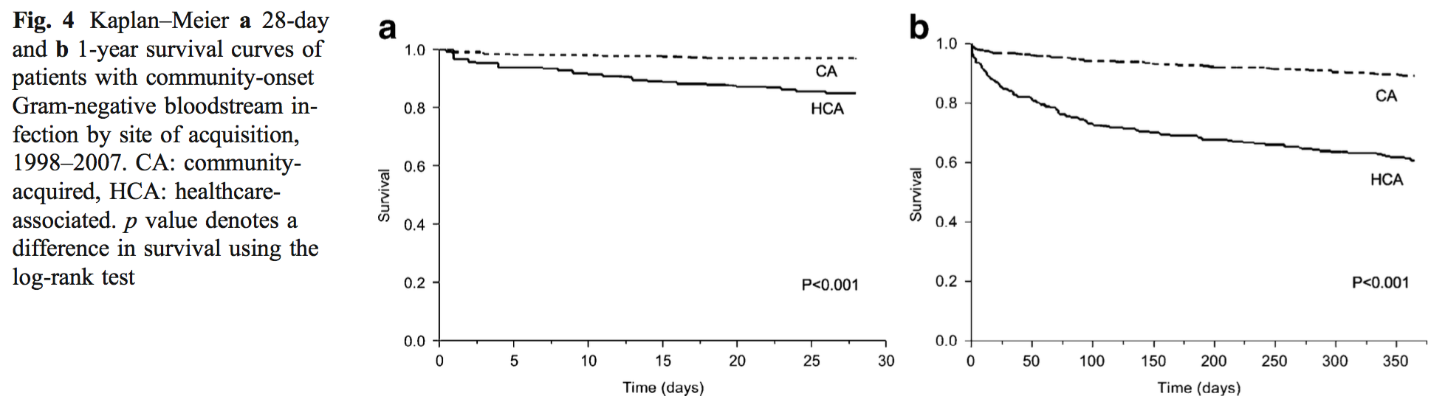
RESULTS Mortality
Notes:
Patients with healthcare-associated Gram-negative BSI had a higher 28-day and 1-year mortality.

Slide 20
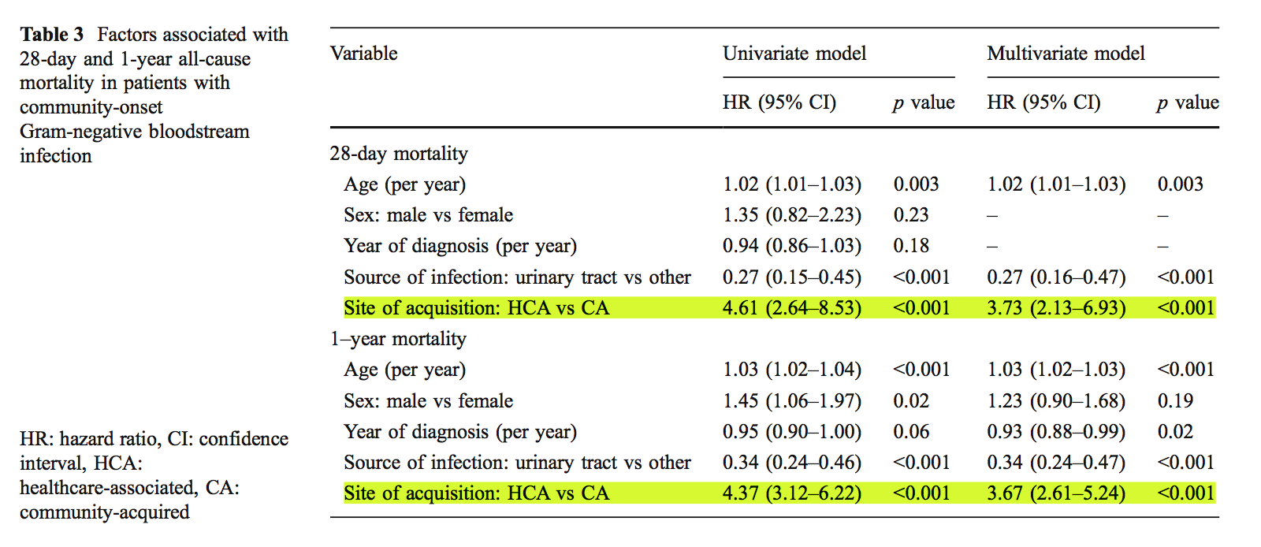
RESULTS Mortality
Notes:
Patients with healthcare-associated Gram-negative BSI had a higher 28-day and 1-year mortality.

Slide 21

FINDINGS
How to use research results to improve the therapy of BSI?

Slide 22
FINDINGS
HCA patients should receive empiric antimicrobial agents that are not associated with a transient increase or induction of AmpC β-lactamase production
Inappropriate empiric antimicrobial therapy associated with increased mortality
The inherent resistance mechanisms of P. aeruginosa and AmpC β-lactamase-producing Enterobacteriaceae requires special attention
Notes:
The administration of inappropriate empiric antimicrobial therapy in patients with Gram-negative BSI has been associated with increased mortality
The inherent resistance mechanisms of P. aeruginosa and AmpC β-lactamase-producing Enterobacteriaceae requires careful selection of empiric antimicrobial regimen.
Patients with healthcare-associated Gram- negative BSI should receive empiric antimicrobial therapy with antipseudomonal activity, including piperacillin- tazobactam, ticarcillin-clavulanate, ceftazidime, cefepime, carbapenems (excluding ertapenem), and aztreonam.
So we suggest patients with healthcare-associated Gram-negative BSI should receive empiric antimicrobial agents that are not associated with a transient increase or induction of AmpC β-lactamase production, including cefepime and carbapenems

Slide 23
STRENGTHS & LIMITATIONS
Strengths
Population based design
Large sample size
Prolonged follow-up facilitated by the REP

Slide 24
STRENGTHS & LIMITATIONS
Limitations
Similar population characteristics
Data from one geographical area
No data on chronic underlying medical conditions and previous exposure to antimicrobial agents

Slide 25
Conclusions

Slide 26
CONCLUSIONS
Gram-negative BSI | Healthcare-associated | Community-acquired
Short-term Mortality | Relatively High | Relatively Low
Long-term Mortality | Relatively High | Relatively Low
Causative Pathogen | Escherichia coli, Pseudomonas aeruginosa, Enterobacter species | Escherichia coli
Antimicrobial Resistance | Relatively High, especially for Fluoroquinolone | Relatively Low
To identify patients with healthcare-associated acquisition of Gram-negative BSI
To optimize empiric antimicrobial therapy based on causative pathogen and antimicrobial resistance
Include antimicrobial agents with anti-pseudomonal activity & without inducing AmpC β-lactamase production
Discourage the use of fluoroquinolone monotherapy for the empiric treatment

Slide 27

THANKS!
Any questions?

